Slide 1
ENSE 470, Milestone 6
Group Eh?
Nickolas Schmidt, Quinn Bast, Abdulaziz Alghamdi
March 29th 2018

Slide 2

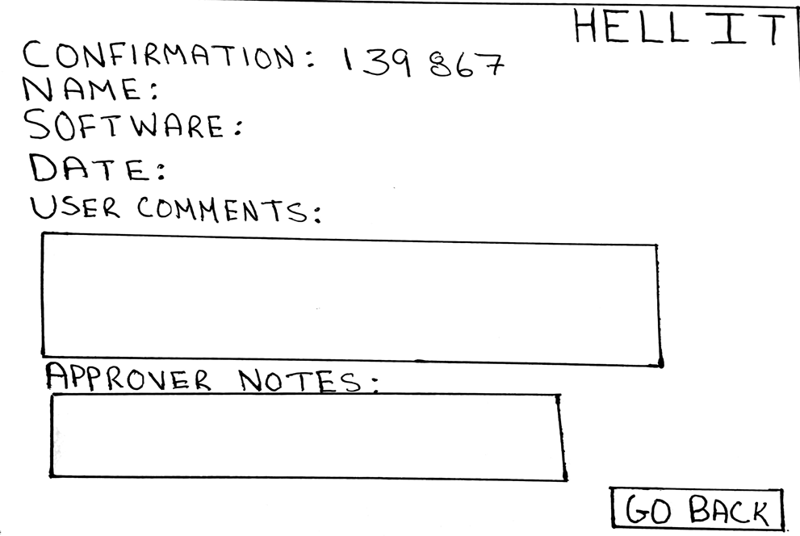
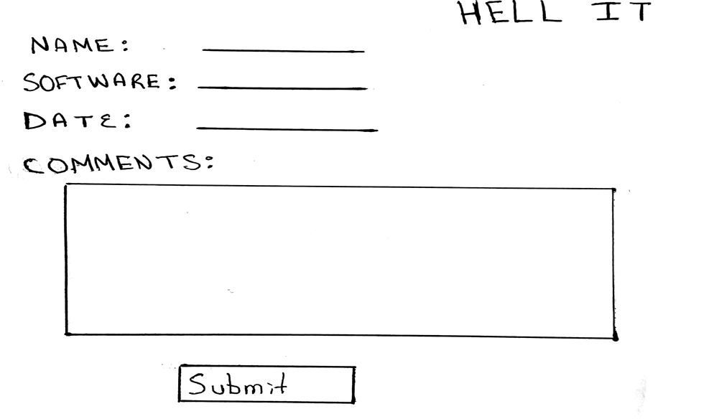
Executive summary
Technology used
MySQL, HTML, PHP, JavaScript, CSS
Lo-fi interface(s) overview (major screens/message flows)

Slide 3
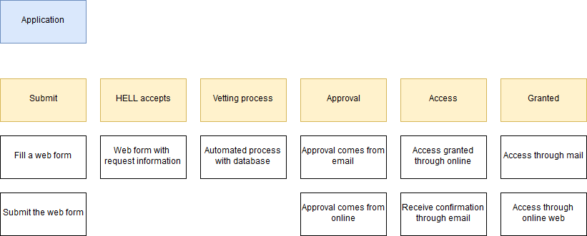
Demo
Highlight MVP for release 1 (what was “done”)
Design patterns used?
What, where, why, how?

Slide 4
Group reflection
How did you feel about this milestone? What did you like about it? What did you dislike?
This milestone was the most satisfying to complete because we created a website and database to fully capture what we wanted to accomplish
What did you learn about yourself as you collaborated and worked through this milestone?
We learned that we have become great and splitting up the work and getting it done at a reasonable time and avoiding the struggle of rushing to complete the milestone the night befoer
How will you use what you have learned going forward?
The knowledge gained about design patterns and Lo-Fi and Hi-Fi models will help us bring our future projects to life as we complete our capstone project and move on into the work force.
What “stuff & things” related to this milestone would you want help with?
None really, we knew what was needed of us early on in the semester and have worked all semester long to design and implement this website

